Slide 1
TheAnalyticsTeam
Sprocket Central Pty Ltd
Data Analytics Approach
Deeti Pranay Kumar

Slide 2
Project analysis slide 2
Data Analytics Approach
Data Exploration
Approach
Interpretation
Model Development
Wealth Segmentation Analysis

Slide 3
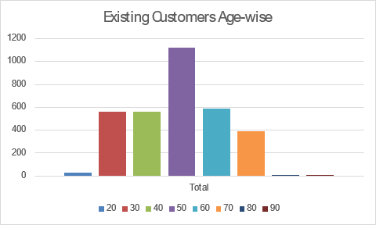
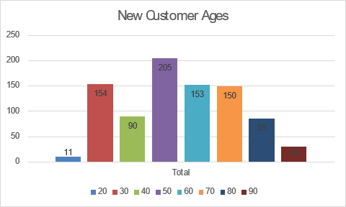
Project analysis slide 3
Data Exploration
Customers- Age Analysis.
As we can see, mostly our new customers are between 25 to 48 years old.
Number of customers from 48 to 59 years old has big drops on percentages.
Most of our customers fall under 40-60 category.
In the age group around 20, 80+ we have lowest number of customers.
Most of the other age categories follow similar trend except the category 70,80 where there seems to be a rise in the new customers.

Slide 4
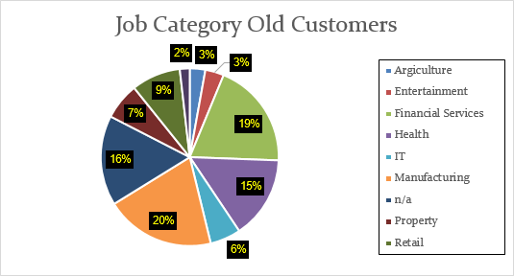
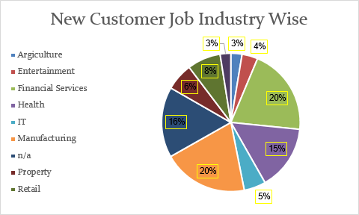
Project analysis slide 4
Data Exploration
Customers- Jobs Analysis.
Manufacturing accounts to 20% of the population distribution which remains the same for the new as well.
The overall distribution for all the job categories remains the same with very less change.

Slide 5
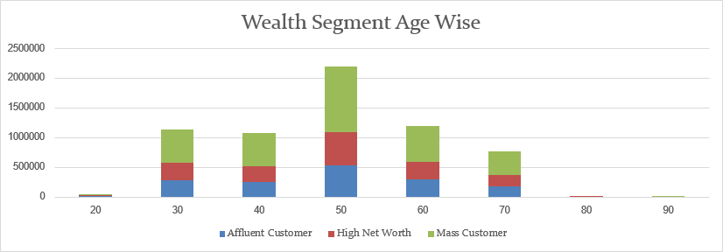
Project analysis slide 6
Wealth Segmentation Analysis
Wealth Segmentation Analysis
Most of the customers fall under Mass Customer categories which remains dominant across all age groups.
For the age of 80 we mostly have High Net Worth Clients only.
For the remaining age groups these follow 2:1:1 ratio.

Slide 6
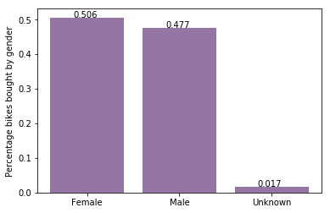
Project analysis slide 5
Model Development
Bike purchases last 3 years
As we can see, our new customers mostly Female with 50.6% purchases with total of 25,212 bikes
Male contributed to 47.7% purchases with 23,765 bikes
So we should focus on advertises on Female customers than Male customers

Slide 7
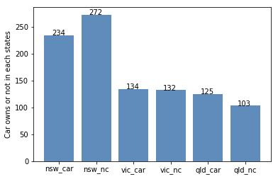
Project analysis slide 7
Interpretation
NSW should be considered the most since numbers of customers don’t own cars is significantly larger than that own.
VIC and QLD has more customers that own car that who don’t but we can try to have something so that those owns car will buy bikes.

Slide 8
Thank You

